Slide 1
Mom Says
Mobile Application
Main Github:
https://github.com/bsch2-group-h-2018/mom-says
Notes:
Rehan will do introduction
Quick intro what the application is
Functionalities

Slide 2
Group H
STUDENT NAME | STUDENT NUMBER
Jodeyne Teneza | x16408022 | BSHC
Penuel Maypa | x16382003 | BSHC
Lee Sharidan | x16353613 | HCC
Alpheus Kakkattupara | x16120078 | HCBC
Rehan Naeem | x16333223 | BSHC
Project Manager
Penuel Maypa

Slide 3





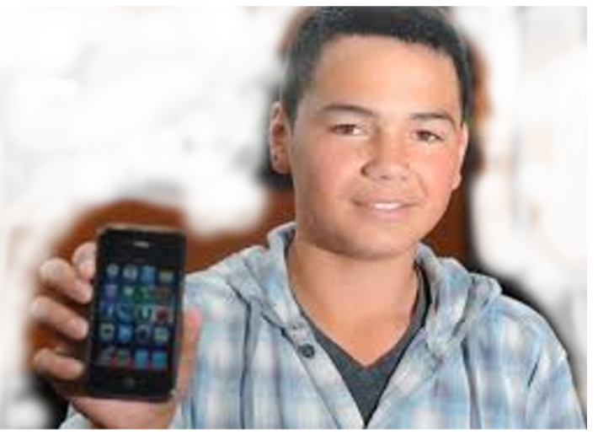
Chore Management System
Mom Says
Messaging Service API
App

Slide 4
Chore Management System
Mom Says
The idea of the app is to let a parent or admin send chores to a child account
Children gain XP points after each chore is done, these XP points can build up to a reward
This app could be further developed in the future into businesses with managers sending staff tasks to be done

Slide 5
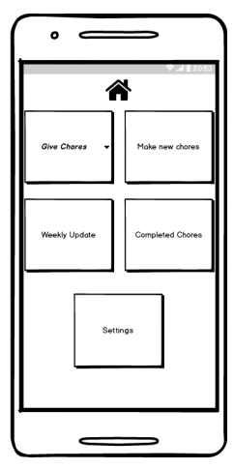
Mom Says
Send the chores to one or more children
Schedule Reminder
Send out constant reminder via text through Viber or WhatsApp etc.
Re-occurrence option -- daily, weekly
Reward System

Slide 6





Technologies
Android Studio as our main IDE
Google's Firebase Services for our Back-End
Firebase Real-time NoSQL Database.
- Stored as JSON Object
Firebase Authentication .
CloudRail's API to programmatically send and receive messages via messaging services.

Slide 7
JODEYNE
- GUI / UI
- Main Package
- Database Integration
- Graphic Design
Responsibilities
PENUEL
- Project Manager
- Firebase Admin / Manager
- Database Integration
- Main Packege
- Version Control Manager
- Testing / Bug Fixer
Alpheus
- Firebase Authentication/ Integration
- Score System
- Main Package
Rehan
- Main Package
- CloudRail API messaging Integration
- Score System
LEE
- Firebase Authentication / Integration
- Log In and Registration
- Main Package

